Slide 1

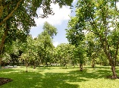
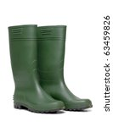


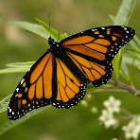
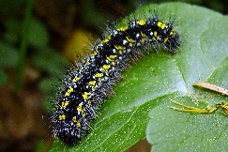


In reading we will:
Learn our Set 1 and Set 2 sounds in phonics groups.
Listen carefully to a range of stories about outdoors.
Learn tricky words, words that we can not sound out, such as the, my and he.
Think about character, settings and atmosphere in the stories we read and hear.
Answer simple retrieval and inference questions.
Ask wonder questions to develop our understanding of the characters and the plot.
Come Outside!
Spring – Term 4
What I will be learning in school:
In communication and language we will:
Ask how and why questions.
Retell a story with story language.
Describe events and experiences in some detail.
Learn rhymes, poems and songs.
Listen attentively and follow instructions.
Listen to and talk about stories to build familiarity and understanding.
In writing we will:
Introducing Drawing Club
Write for purpose through role play and continuous provision.
Use our phonics knowledge to write simple words and phrases.
Begin to use finger spaces, capital letter and full stops.
Form letters correctly using a tripod pencil grip.
Explore rhythm and rhyme in poetry.
Reread our sentences to check they make sense.
Build our vocabularies by exploring and enjoying new words.
In expressive art and design we will:
Learn and perform traditional nursery rhymes.
Add instruments to our rhymes and songs on Charanga.
Listen to and appreciate a range of songs .
Explore beat and rhythm with clapping and playing the glockenspiels.
Use a range of art supplies to create Easter cards and artwork.
Create painted symmetrical butterflies
Role play as life cycle of the butterfly – dress up as Caterpillars and butterflies.
In maths we will:
Explore numbers to 10 through partitioning and grouping strategies.
Compare and order numbers. Find one more and one less of numbers to 10.
Begin to explore addition and subtraction strategies.
Rote count to 20 and beyond.
Explore symmetry
Explore ordinal numbers such as first, second and third.
Explore 2D and 3D shapes through patterns and construction.
In understanding the world we will:
Life cycles of a butterfly.
Planting and growing.
Discussing the world around us – the beautiful outdoors.
Joining in with weekly Wellie Wednesday sessions outdoors.
Weather changes and signs of Spring.
Celebration of Easter and Lent
In physical development we will:
Build our fine motor skills through threading, cutting and weaving.
Develop our pencil grip and letter formation continually.
Develop out co-ordination by using equipment.
Develop our throwing and catching skills.
Move and dance to music.
In personal, social and emotional development we will explore:
Friendships and how to be kind to others.
Our dreams, goals and hopes for the future.
How to show resilience and perseverance in the face of challenges.
Turn taking, the importance of listening and being polite to others.

