Slide 1
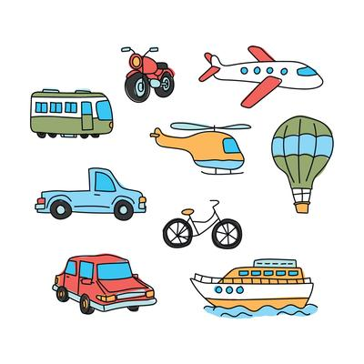


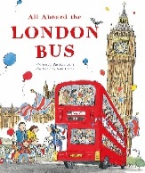
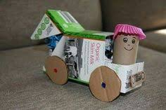

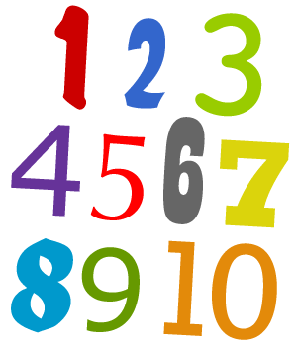


In reading we will:
Learn our Set 1 and Set 2 sounds in phonics groups.
Explore poetry linked to our transport topic.
Listen carefully to a range of stories about transport and journeys.
Learn tricky words, words that we can not sound out, such as the, my and he.
Think about character, settings and atmosphere in the stories we read and hear.
Answer simple retrieval and inference questions.
Ask questions to develop our understanding of the characters and the plot.
Ticket to Ride!
Summer – Term 5 2025
What I will be learning in school:
In communication and language we will:
Ask how and why questions.
Retell stories with story language.
Describe events and experiences in some detail.
Learn rhymes, poems and songs.
Listen attentively and follow instructions.
Listen to and talk about stories to build familiarity and understanding.
In writing we will:
Enjoy daily Drawing Club sessions. our Drawing Club stories- All Aboard the London Bus by Praticia Toht, A day with the Animal Builders by Sharon Rentta, Whatever Next, You Can’t take an Elephant on the Bus by Patricia Cleveland.
Write for purpose through role play and continuous provision.
Use our phonics knowledge to write simple words and phrases.
Begin to use finger spaces, capital letter and full stops.
Form letters correctly using a tripod pencil grip.
Reread our sentences to check they make sense.
Build our vocabularies by exploring and enjoying new words.
In expressive art and design we will:
Design and make vehicles using construction resources.
Learn and perform traditional nursery rhymes.
Listen to and appreciate a range of songs .
Explore beat and rhythm with clapping and playing the glockenspiels.
Use a range of art supplies to create pictures and cards.
Role play as a passenger, traveler and driver of different transport.
Set up and create outdoor large role play – Train, bus, taxi , plane etc.
In maths we will:
Explore numbers to 10 through partitioning and grouping strategies.
Compare and order numbers. Find one more and one less of numbers to 10.
Begin to explore addition and subtraction strategies.
Rote count to 20 and beyond.
Explore ordinal numbers such as first, second and third.
Explore 2D and 3D shapes through patterns and construction.
Investigate measurements and capacity.
In understanding the world we will:
Introduce a range of transport, including emergency vehicles.
Explore maps and how they can be used to travel.
Discuss how we travel to school and what mode of transport we use.
Compare transport from the past with transport in the present.
Explore forces- push and pull.
Discuss the importance of road safety and how to stay safe near the railway.
Experience a local walk and ride on a local bus.
In physical development we will:
Build our fine motor skills through threading, cutting and weaving.
Continue to develop our pencil grip and letter formation continually.
Develop our handwriting.
Develop out co-ordination by using equipment.
Develop our throwing and catching skills.
Learn to ride a balance bike.
Move and dance to music.
In personal, social and emotional development we will explore:
Friendships and how to be kind to others.
Our dreams, goals and hopes for the future.
How to show resilience and perseverance in the face of challenges.
Turn taking, the importance of listening and being polite to others.

