Slide 1

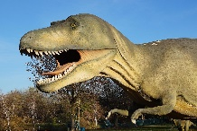







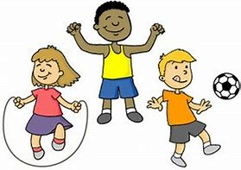


Reading:
Joining in with rhymes and showing an interest in stories with repeated refrains
Having a favorite story/rhyme
Sequencing familiar stories through the use of pictures to tell the story
Recognising initial sounds Engage in ex
Phonic Sounds: RWI Set 1 whole class
Initial sounds
Oral blending
Reciting known stories
Teachers listening to me read aloud, ensuring books are consistent with my developing phonic knowledge
Stomp And Roar!
Autumn term
What I will be learning in school:
Communication and Language:
Settling in activities
Making friends
Talking about experiences that are familiar to me
What are my passions / goals / dreams?
Rhyming and alliteration
Sharing facts about me and my family!
Model talk routines through the day. For example, arriving in school: “Good morning, how are you?”
Whole EYFS Focus – C&L is developed throughout the year through high quality interactions, daily group discussions, sharing circles, PSE times, stories, singing, speech and language interventions, EYFS productions, assemblies and weekly Wellcomm interventions.
Personal Social and Emotional Development:
New Beginnings
Seeing myself as a valuable individual
Being me in my world
Class Rules and Routines
Supporting me to build relationships
Dreams and Goals
Mathematics:
Counting rhymes and songs
Matching equal and unequal sets
Comparing objects and sets
Subatising
Ordering objects and sets / introduce manipulatives.
Number recognition
2D Shapes
Recognise, describe, copy and extend colour and size patterns
Count and represent the numbers 1 to 3
Estimate and check by counting.
Recognise numbers in the environment.
Expressive Art and Design:
Join in with songs
Beginning to mix colours,
Join in with role play- home.
Build models using construction equipment.
Self-portraits
Family portraits
Junk modelling
Exploring sounds and how they can be changed
Tapping out of simple rhythms.
Understanding the world:
Identifying my family. Commenting on photos of my family; naming who they can see and of what relation they are to them.
Can talk about what I do with my family and places I have been with my family.
Name and describe people who are familiar to me.
Navigating around our classroom and outdoor areas. Create treasure hunts to find places/ objects within our learning environment.
Dinosaur facts – visit the library and explore information books.
Long ago – How time has changed. Word of the topic – Extinct. Dinosaurs lived millions of years ago.
Introduction to Welly Wednesday!
Physical Development:
Threading
Cutting
Weaving
Playdough
Dough Disco
Draw lines and circles using gross motor movements
Hold pencil/paint brush beyond whole hand grasp
Cooperation games i.e. parachute games
Climbing – outdoor equipment
Different ways of moving to be explored with children
Develop good personal hygiene
Providing regular reminders about thorough handwashing and toileting.
Writing:
Introduction to Drawing Club
Dominant hand
Model Tripod pencil grip
Mark making - giving meaning to marks and labelling.
Writing initial sounds
Use initial sounds to label characters / image
Names
Handwriting patterns
Letter formation

