Slide 1








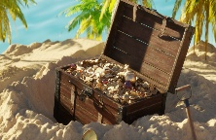

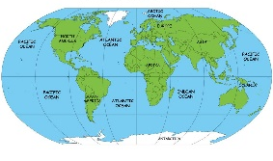
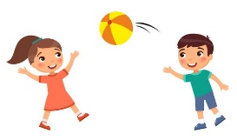

In reading we will:
Review and learn Set 1, Set 2 and 3 sounds in phonics groups.
Explore poetry and rhyme linked to sea creatures/ocean
Listen carefully to a range of stories about the seaside and under the sea.
Learn tricky words (Red words) , words that we can not sound out, such as the, my and he.
Think about character, settings and atmosphere in the stories we read and hear.
Answer simple retrieval and inference questions.
Ask questions to develop our understanding of the characters and the plot.
Enjoy whole class Book Talk and Secret Storyteller.
Ahoy! Ocean Explorers!
Summer – Term 6 2026
What I will be learning in school:
In communication and language, we will:
Chatter Matters! Daily Time to Talk
Ask how and why questions.
Retell a story with story language.
Describe events and experiences in some detail.
Learn rhymes, poems and songs.
Listen attentively and follow instructions.
Wellcomm Interventions
Listen to and talk about stories to build familiarity and understanding.
In writing we will:
Drawing Club – Write sentences describing the characters and settings of stories- Don’t eat the teacher, Snail and Whale, Barry the fish with fingers.
Write for purpose through role play and continuous provision.
Write labels for own models.
Use our phonics knowledge to write simple sentences and phrases.
Begin to use finger spaces, capital letter and full stops.
Form letters correctly using a tripod pencil grip.
Explore rhythm and rhyme in poetry- Commotion in the Ocean,
Shark In The Park.
Build our vocabularies by exploring and enjoying new words.
In expressive art and design, we will:
Design and make boats – experiment with floating and sinking
Create treasure maps and make/decorate treasure boxes
sandcastles with sand and salt dough.
Learn and perform rhymes and songs – Perform Reception Liturgy to an audience.
Listen to and appreciate a range of songs.
Enjoy a Pirate party – dance and sing songs! Dress-up as pirates!
Use a range of art supplies to create pictures and cards- Fathers day.
Role play as an explorer, tourist or beach visitor, outdoors – ice-cream kiosk.
In maths we will:
Continue to build our understanding of numbers to 10.
Begin to share into equal groups.
Recognise doubles.
Begin to explore addition and subtraction strategies.
Rote count to 20 and beyond.
Explore number patterns such as odd and even.
Explore 2D and 3D shapes through patterns and construction.
Investigate measurements and capacity and use the key vocabulary; empty, full etc
In understanding the world we will:
Name and begin to locate the world’s oceans on a map.
Sort sea creatures into groups.
Visit the school library to find out interesting facts about sea creatures.
Explore shells, seaweed etc. Use all of our senses.
Discuss different parts of the beach such as rock pools and piers.
Discuss the importance of water safety and how to stay safe at the beach.
Begin to explore the ocean and the animals that live there.
In physical development we will:
Continue to build our fine motor skills through threading, cutting and weaving.
Develop our pencil grip, sitting position and letter formation continually-
Daily handwriting – Kinetic Letters.
Develop our co-ordination by using equipment.
Develop our throwing and catching skills. Sports day
Begin to develop our spatial awareness in team games.
Move and dance to music in PE
In personal, social and emotional development we will explore:
Dentist visit – Caring for our teeth, Daily tooth brushing launch.
Feelings linked to the story Colour Monster
Friendships and how to be kind to others.
Our dreams, goals and hopes for the future.
How to show resilience and perseverance in the face of challenges.
Turn taking, the importance of listening and being polite to others.
Transitions and getting ready to move to Year 1.

