Slide 1
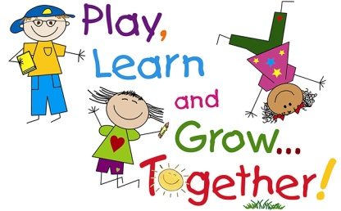

Personal, Social and Emotional Development
Keeping our teeth clean – Teeth brushing
Developing relationships with other children and adults.
Sharing and turn taking.
Talking about how we can regulate our feelings. Create calming space/box
Understanding their own feelings and feelings/wishes of others- ‘Colour Monster’.
Circle time.
Communication and Language
Talk Boost Intervention x3 weekly
Phase 1 – Rhyme and alliteration focus ;Enjoy rhyming songs and stories.
Understand simple sentences.
Talking to our friends and teachers.
Talking about what we like and our special families.
friendship
explore
Literacy
Sharing stories of children’s interests voted by the children; ‘Dinosaurs love underpants’ , ‘Mr Wolf’s Pancakes’, ‘We are going on a Bear Hunt/Easter Egg Hunt’ , Dear Zoo.
Learning story making text – ‘The Little Green Dinosaur’. (Script will be sent home for you to share with your child).
Experiment with mark making
Developing fine motor skills.
fun
St Thomas More Pre School
Physical Development
Lemon squeezing , pancake flipping and races
Daily ‘Dough Disco’
Moving around the setting safely
Taking risks in a safe environment
Weekly PE sessions in school hall- developing Fine and gross motor skills.
Cutting skills- focus on scissor control
Daily tooth brushing – oral hygiene focus following dentist visit.
Putting on my own coat – manage my zips, buttons , shoes and fastenings.
Independent tolieting
Planning overview –
Topic – ‘Stomp and Roar’
Spring Term 4 2022
Understanding the World
Seasons- Spring walk outdoors, explore using all our senses! Enjoy hands –on exploration of natural materials.
Show interests in different occupations- Visits from Author, police , firefighter, vet this term.
Continue to develop positive attitudes about differences between people.
play
Mathematics
Careful counting of objects.
Linking numerals 1-5 focus to amounts.
Number of the week.
Positional language- explore through words linked to the Bear Hunt/Easter egg hunt- “under the table, behind, in front of’ “etc.
Compare quantities using language – ‘More than’ , ‘fewer than’.
Counting songs, rhymes and games- showing ‘finger numbers’ up to 5.
safe
Helpful notes for parents/carers
We will be having parent consultations at the end of this term ; this will be a chance to meet face-to-face with your child’s key person to discuss progress, celebrate strengths and share next steps. Dates and times will be sent out soon.
Please complete WOW vouchers for your child and send them back in to us so we can celebrate these magical moments together.
Encourage independence at home -putting on their own coats and shoes ready for school.
Expressive Arts and Design
Imaginative play – role play – Zoo
Listening to music – singing songs, making sounds, moving to music, experimenting with musical instruments. Learn ‘Down in the Jungle song with instruments’
Art skills – Encourage free painting, printing and collage of children's’ favourite Wild animals .
Building models using construction kits.

