Slide 1
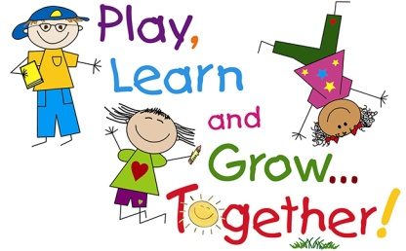

Personal, Social and Emotional Development
Settling in, feeling safe and happy.
Developing relationships with other children and adults.
Boundaries and routines.
Understanding their own feelings and feelings/wishes of others.
Circle time.
Transitions
friendship
Communication and Language
Phase 1 speaking and listening games
Speaking and listening in a range of situations. Sound walk in school ground
Weekly Talk Boost small group
Enjoy rhyming songs and stories.
Understand simple sentences.
Talking to our friends and teachers.
Talking about what we like and our families.
explore
fun
Literacy
Phase 1 listening games
Share stories and reading books.
Learning story making text – Busters Birthday.
Experiment with mark making
Drawing pictures of ourselves and family.
St Thomas More Pre School
Physical Development
Daily ‘Dough Disco’!
Moving around the setting safely
Taking risks in a safe environment
Climbing and jumping on outdoor equipment.
Fine and gross motor skills.
Hygiene – washing hands,
Sharing a healthy snack.
Drinking from a cup/pouring a drink.
Toileting
Planning overview
This is Me! Autumn Term 1 2022
Understanding the World
Talk about family and friends – similarities and differences.
Small world play – farm, town, train.
ICT – operating mechanical toys – on/off
Celebrations – birthdays, harvest.
Autumn – walk, explore objects.
Using senses – Tasting a range of breads. sensory play
play
Mathematics
Careful counting of objects.
Number names 1-5.
Quantities- more/less
Shapes and colour – what shapes and colours can you see around you?
Size – big/small
Daily Counting songs, rhymes and games.
Numbers of personal significance.
Birthdays
Calendar and routines.
safe
Expressive Arts and Design
Imaginative play – role play – home, birthday party.
Listening to music – singing songs, making sounds, moving to music, experimenting with musical instruments.
Art skills – painting portraits. Printing with hands, leaves, conkers. Mixing colours to make autumn shades.
Building models using construction kits.
Helpful notes for parents/carers
Bring in a family photo for your child to share during circle time.
Look out for your Tapestry activation email.
Relax – your child is in safe hands.

