Slide 1
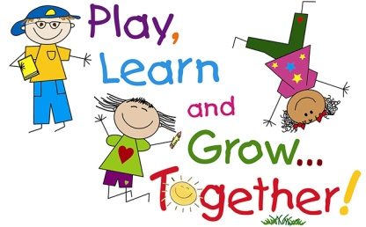

Personal, Social and Emotional Development
Introduction to our shared ‘Rainbow Rules’.
Feeling safe and happy.
Developing relationships with other children and adults- Celebrating Anti –Bullying week
Boundaries and routines.
Understanding their own feelings and feelings/wishes of others.
Being independent and joining in and enjoying a visitor experience.
friendship
Communication and Language
Introduction to small group – ‘Talk Boost ‘ intervention groups
Speaking and listening in a range of situations. Phase 1 games.
Enjoy rhyming songs and stories.
Describing fireworks
Talk time – circle time.
Talking about our feelings.
explore
Literacy
Share stories and rhymes and reading books; Owl Babies, Whatever Next.
Learning story making text – Dear Santa.
Experiment with mark making
Recognising own names.
Developing a pencil grip; experimenting with making marks and patterns- shaving foam /fireworks etc
fun
St Thomas More Pre School
Physical Development
Focus on scissor control and cutting skills.
Daily ‘Dough Disco’!
Moving around the setting safely
Fine and gross motor skills.
Hygiene – washing hands,
Sharing a healthy snack.
Drinking from a cup/pouring a drink.
Toileting
Putting on own coats and shoes.
Planning overview
‘The wonders of the night ‘ Autumn Term 2 2022
Understanding the World
Talk about night and day . Nocturnal animals- owl focus
Stars, space, planets, rockets
Small world play – farm, town, train
Bonfire/fire safety.
Celebrations – Remembrance Sunday, Advent and Christmas
Using senses. Enjoying toasted marshmallows and hot chocolate outdoors!
play
safe
Expressive Arts and Design
Imaginative play – role play – Dark tents, torches, imaginary rocket/space .
Listening to music – singing songs, making sounds, moving to music, experimenting with musical instruments.
Dressing up.
Art skills – Creating calendars. Christmas art!
Building models using construction kits.
Mathematics
Careful 1-1 counting of objects
2D Shape of the week focus.
Shapes and colour – what shapes and colours can you see around you?
Counting songs, rhymes and games- 5 little Men in a flying saucer.
Calendar and routines.
Helpful notes for parents/carers
Bring wellies to stay at Pre school.
Always ensure your child has a named waterproof jacket every session.
All parents will have the opportunity to meet with their child’s key person this term to discuss how their child is settling and next steps.

