Slide 1
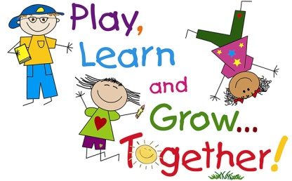

Personal, Social and Emotional Development
Settling in, feeling safe and happy.
Developing relationships with other children and adults.
Sharing and turn taking.
Boundaries and routines.
Understanding their own feelings and feelings/wishes of others.
Circle time.
Communication and Language
Speaking and listening in a range of situations.
Speaking and listening to each other about Christmas experiences.
Phase 1 – Rhyme focus ;Enjoy rhyming songs and stories.
Understand simple sentences.
Talking to our friends and teachers.
Talking about what we like and our special families.
friendship
explore
Literacy
Sharing traditional tales and reading books- ‘The Magic Porridge Pot’ & ‘Goldilocks and the Three Bears’
Learning story making – ‘Going on a dragon Hunt’. (Script will be sent home for you to share with your child).
Experiment with mark making
Developing pencil grip.
fun
St Thomas More Pre School
Physical Development
Daily ‘Dough Disco’!
Moving around the setting safely
Taking risks in a safe environment
Weekly PE sessions in school hall- developing Fine and gross motor skills.
Hygiene – washing hands,.
Daily tooth brushing – oral hygiene focus following dentist visit.
Drinking from a cup & pouring own drink.
Toileting
Planning overview –
Topic – Traditional Tales
Term 3 2023
Understanding the World
Talk about family and friends – similarities and differences.
Our world- places around the world.
Small world play – farm, town, train.
Celebrate Chinese New Year – Year of the Rabbit 2023 .
Seasons- Winter– walk outdoors, explore using all our senses – sensory play with winter objects- experience real and magic snow!
play
Mathematics
Careful counting of objects.
Number names 1-5 focus.
Number of the week.
Number land introduction.
Shapes and colour – what shapes and colours can you see around you?
Positional language.
Comparing Size – big/small, taller, shorter etc.
Counting songs, rhymes and games.
Calendar and routines.
safe
Expressive Arts and Design
Imaginative play – role play – traditional tale puppets and role play, Chinese take away.
Listening to music – singing songs, making sounds, moving to music, experimenting with musical instruments.
Art skills – printing, mixing colours, creating snow, group art pieces, snowmen
Building models using construction kits.
Helpful notes for parents/carers
Please wear face coverings when on school site.
Bring wellies to stay at Pre-school,
Please complete WOW vouchers for your child and send them back in to us so we can celebrate these magical moments together.
Encourage independence at home -putting on their own coats and shoes etc.

