Slide 1


Relationships, Health and Sex Education
St Thomas More Catholic Primary School
Parental Consultation Slides

Slide 2
In the academic year 2020/21, Relationships Education and Health Education became statutory in all primary schools in England. This new subject builds on the non-statutory lessons we have previously taught in RHSE.
Life to the Full is the programme we use
It has been approved by our diocese.
The makers, ‘TenTen’ provide training for teachers in Catholic schools on the subject.

Slide 3
TenTen understand the foundational role that parents have in educating and nurturing their children on these matters. Within the programme, resources which will not only keep you informed about what is being taught in school, but will also give you the opportunity to engage your children in discussion, activity and prayer.
This short power point gives you the brief details of the content and structure of the programme and will introduce Key decisions that as a school we would like your opinion on before finalising the decisions for that content’s delivery
We would like your feedback on our approach
Particularly on the key decisions for the teaching of certain topics.
We have opened a consultation period during which we welcome your feedback.

Slide 4


Slide 5
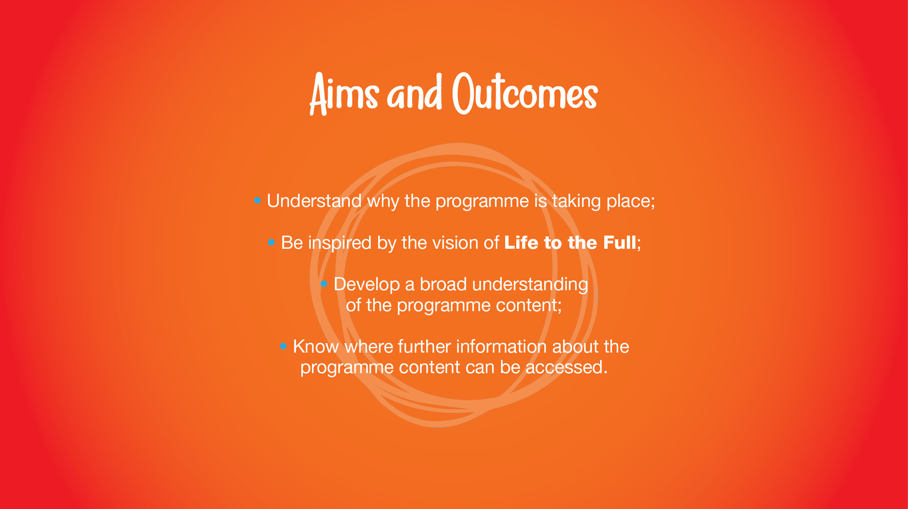
The vision video can be accessed on the TenTen Website Parent Portal

Slide 6

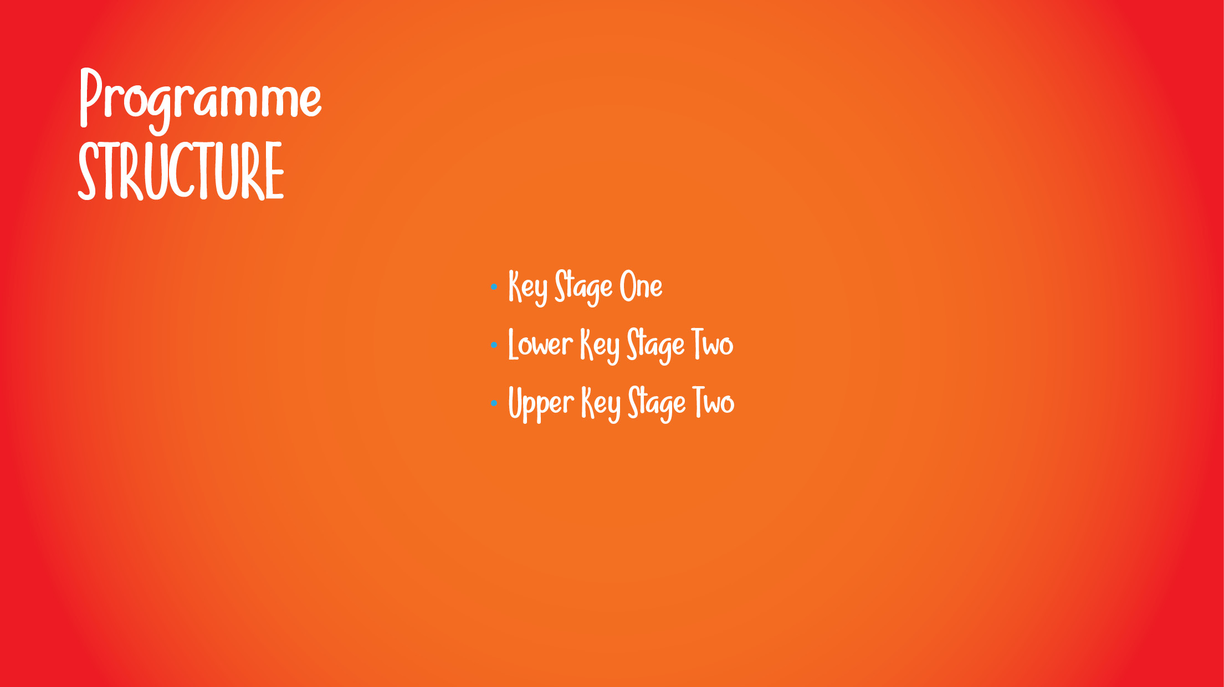
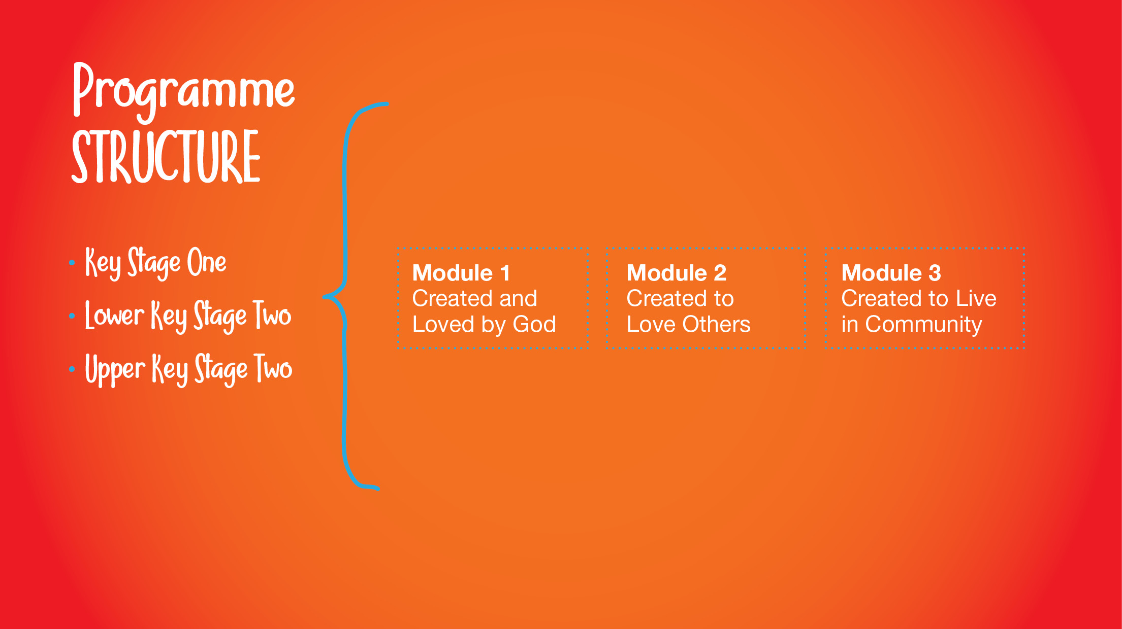
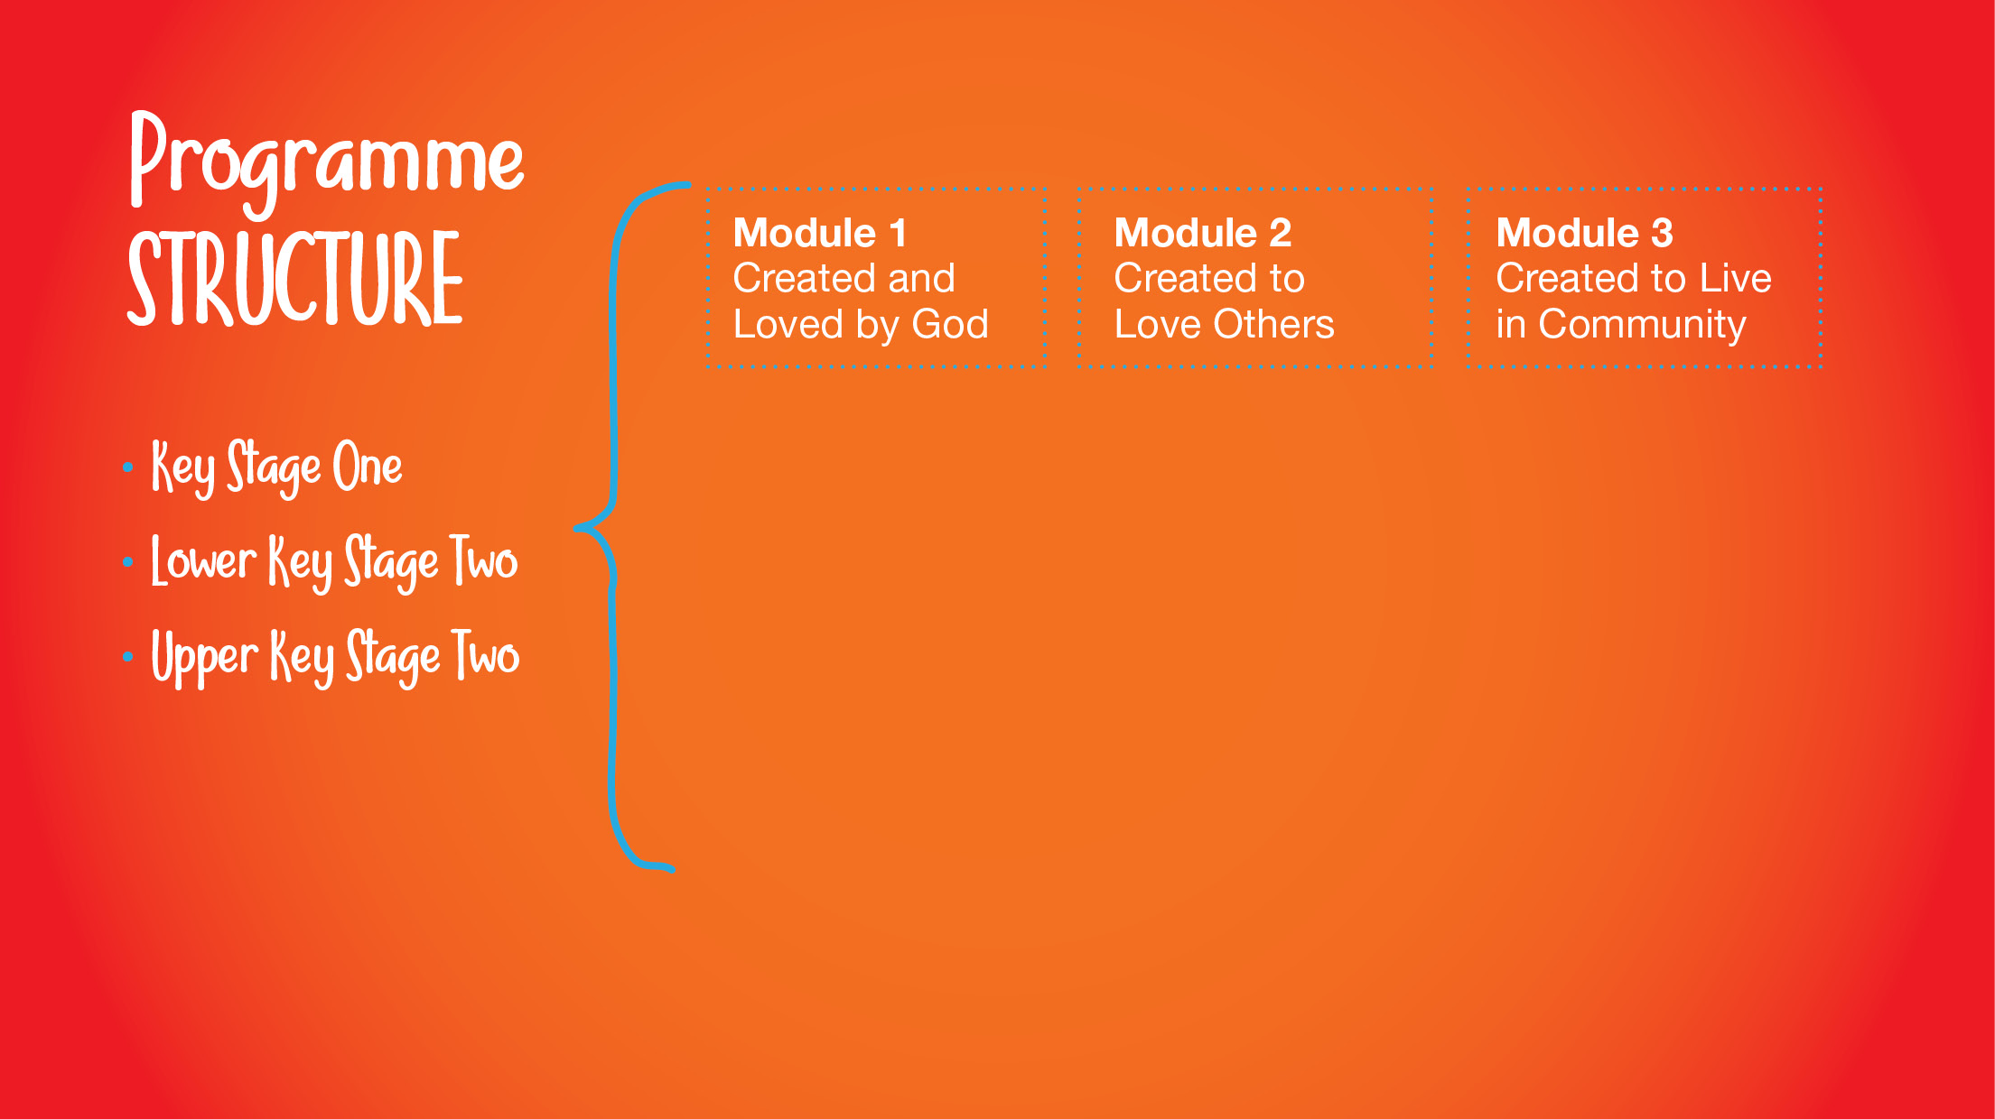
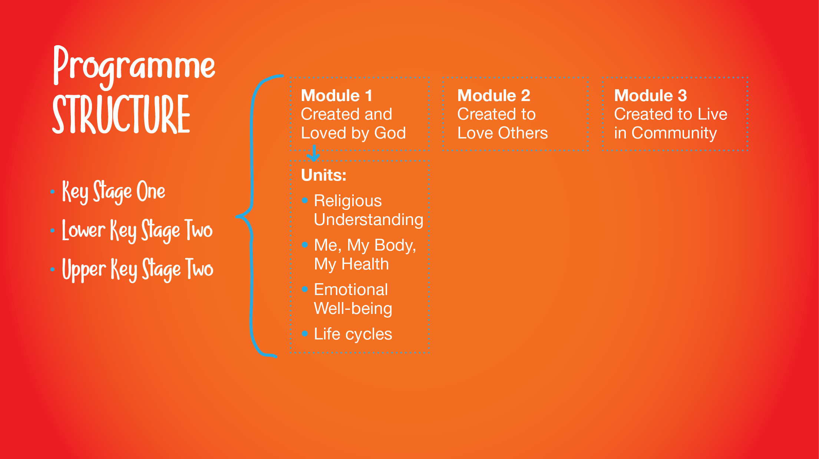
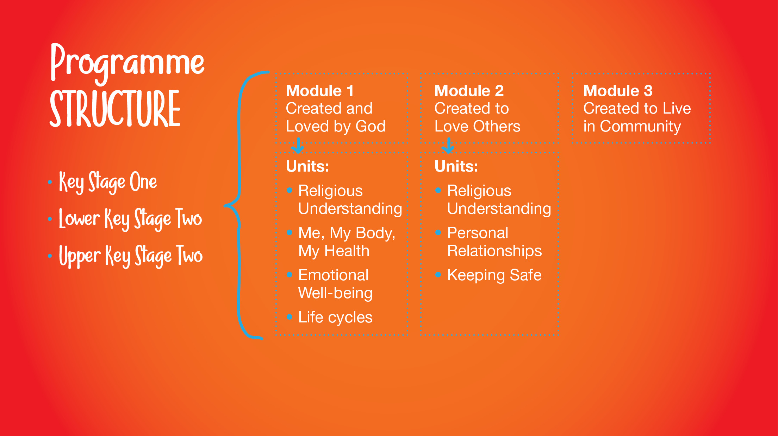
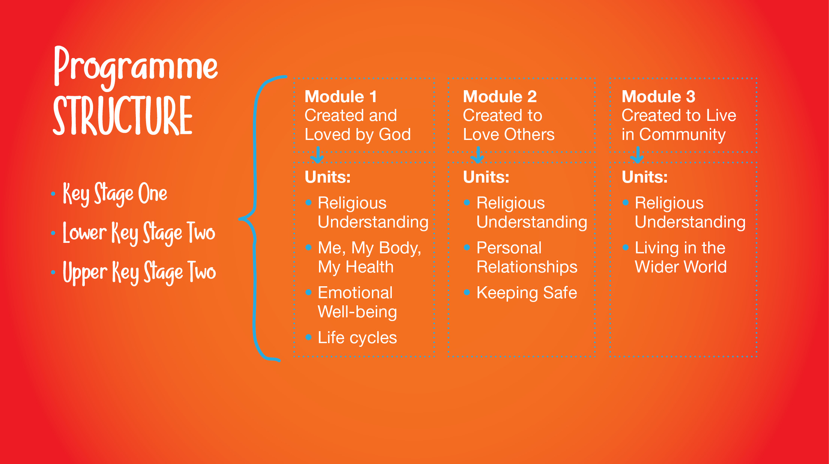
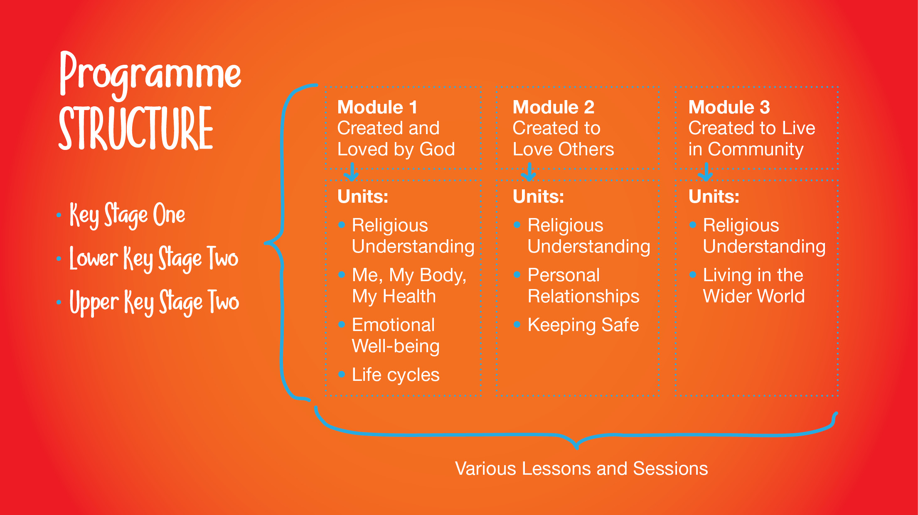

Slide 7
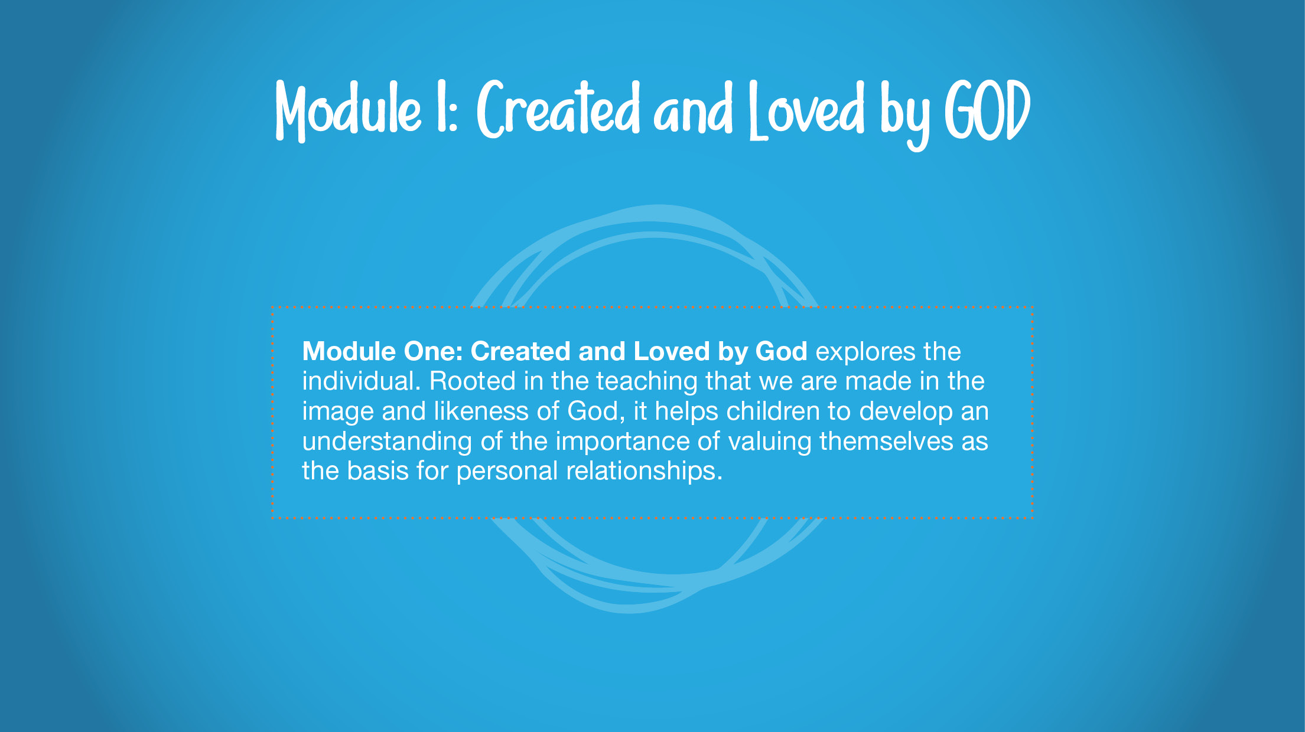

Slide 8
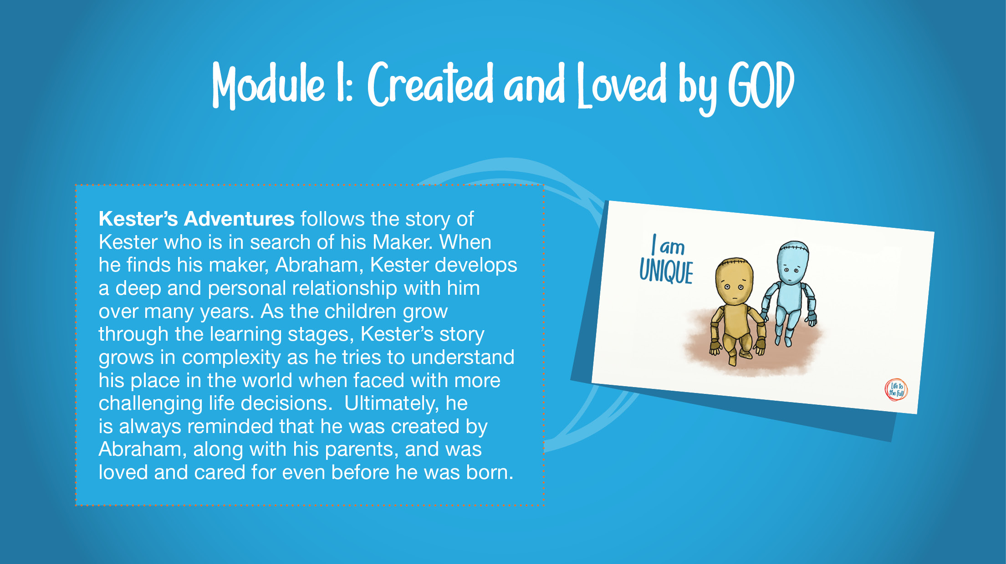

Slide 9
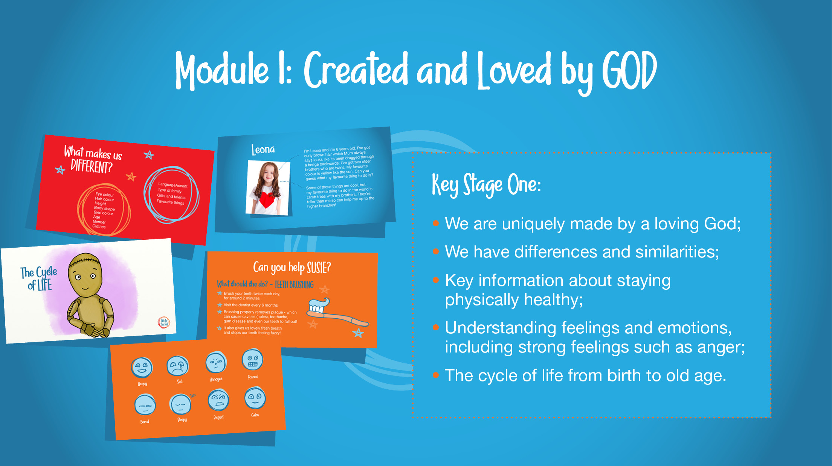

Slide 10
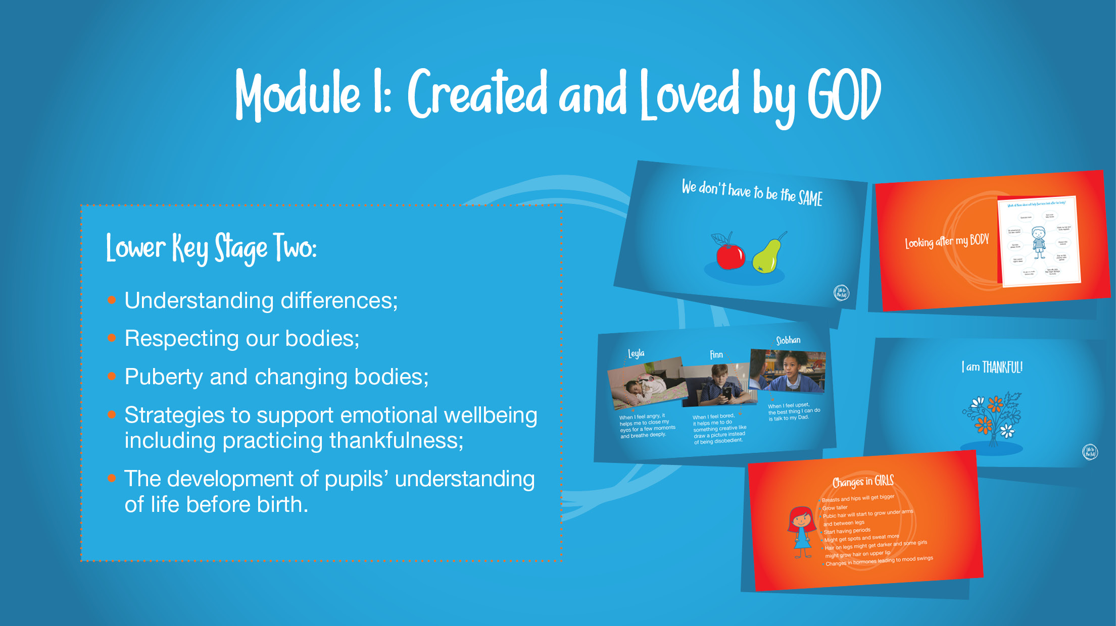

Slide 11
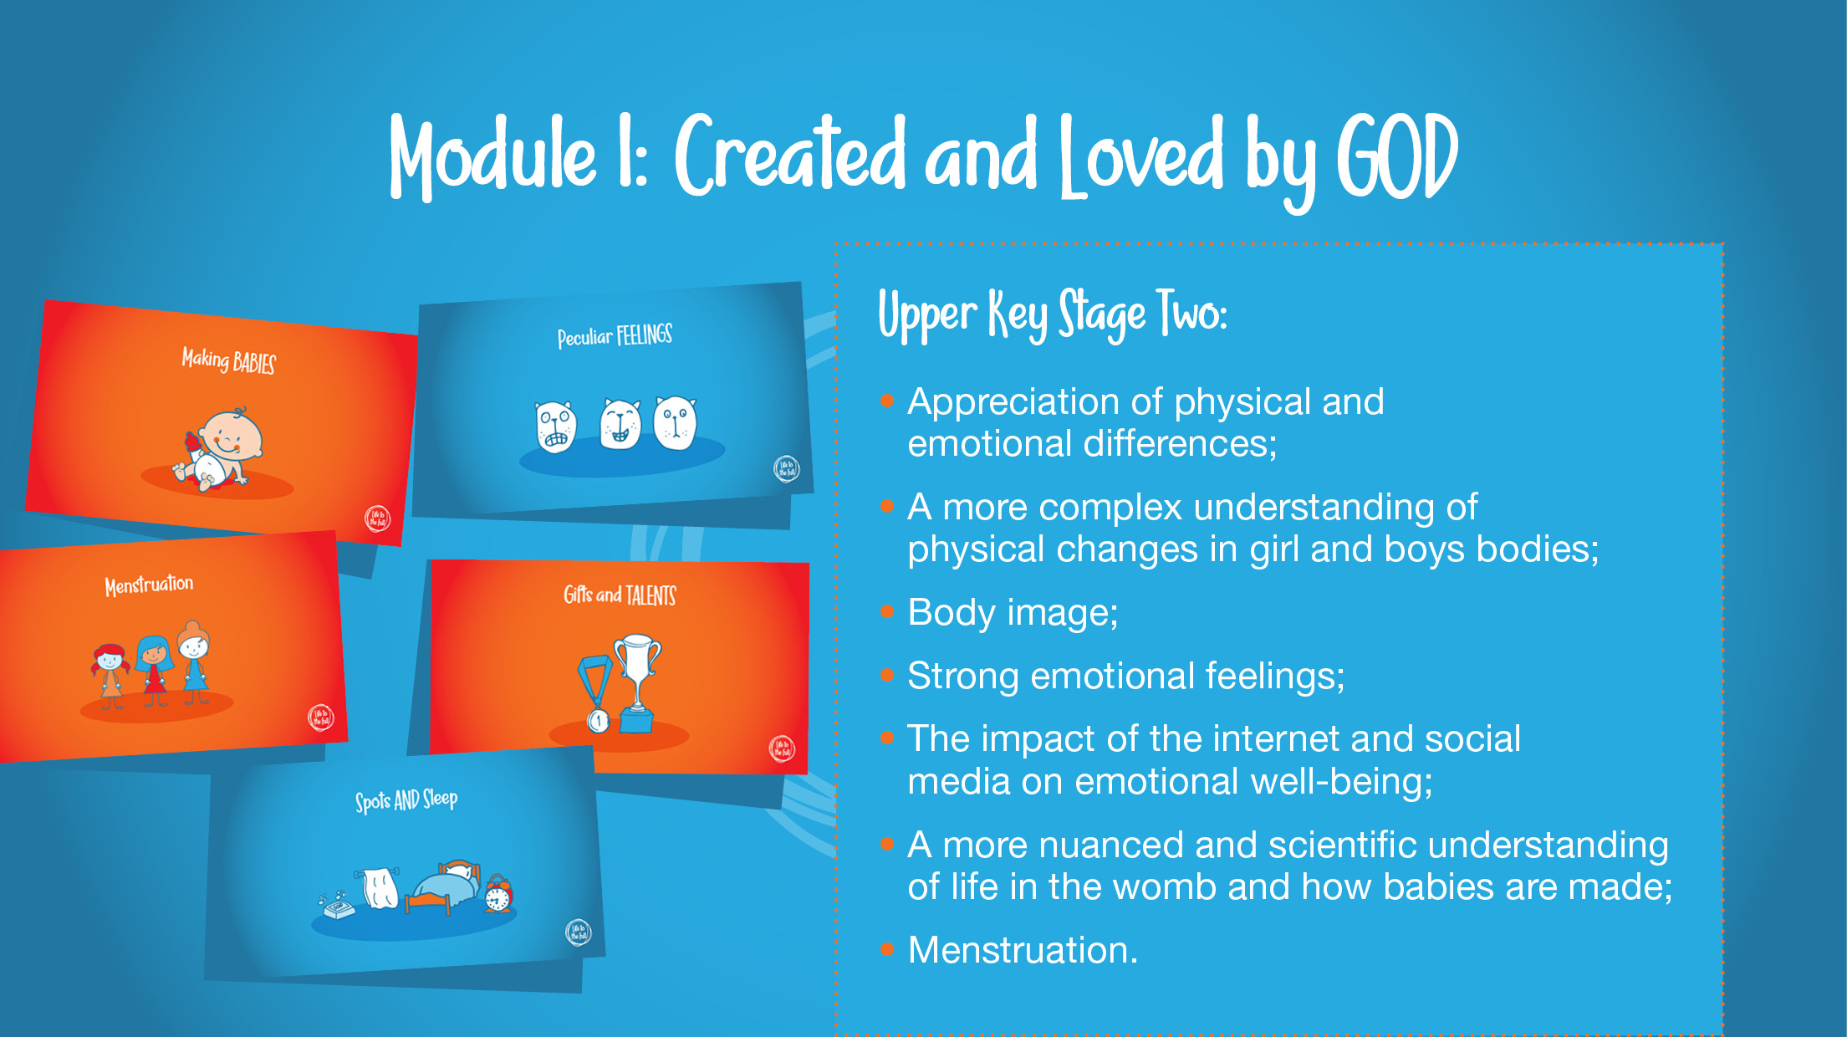

Slide 12
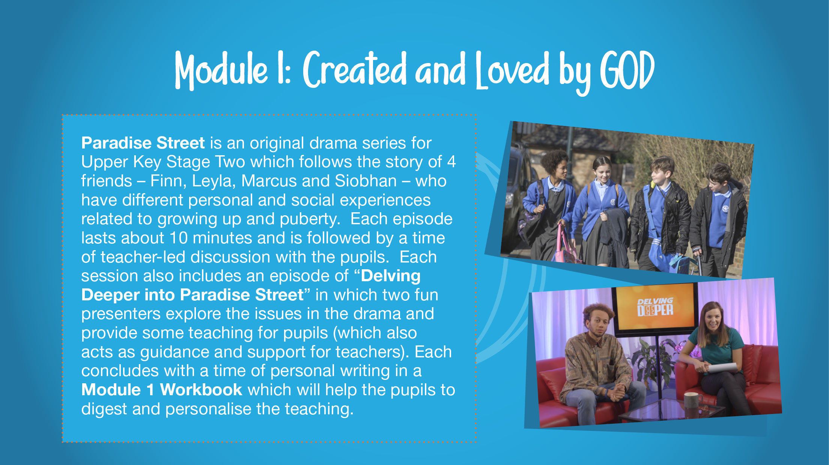

Slide 13
The Relationships Education and Health Education is statutory in all primary schools and guidance states it is compulsory for all children to take part in Relationship and Health Education.
However children can be taken out of the Sex education lessons.
The scheme we use is mostly Relationships and Health Education. Sex Education only takes place in Years 5 and 6 and therefore there are only a couple of lessons that pupils may be withdrawn from.
If you do not wish for your child to take part in Sex Education lessons when in Years 5 and 6 there is a process that must be followed:
1.A letter will be sent to parents to inform them that the Sex Education lessons will be taught soon.
2.Please ring or email the school office saying you are wanting to withdraw your child from the Sex Education Lessons.
3.You will then be called by the Head Teacher, Mrs Tippen, to discuss this wish so she can understand what provision you have in place to be able to teach this to your child, even discussing resources that would be helpful to you.
4.You will then need to put your request in writing to Mrs Tippen.

Slide 14
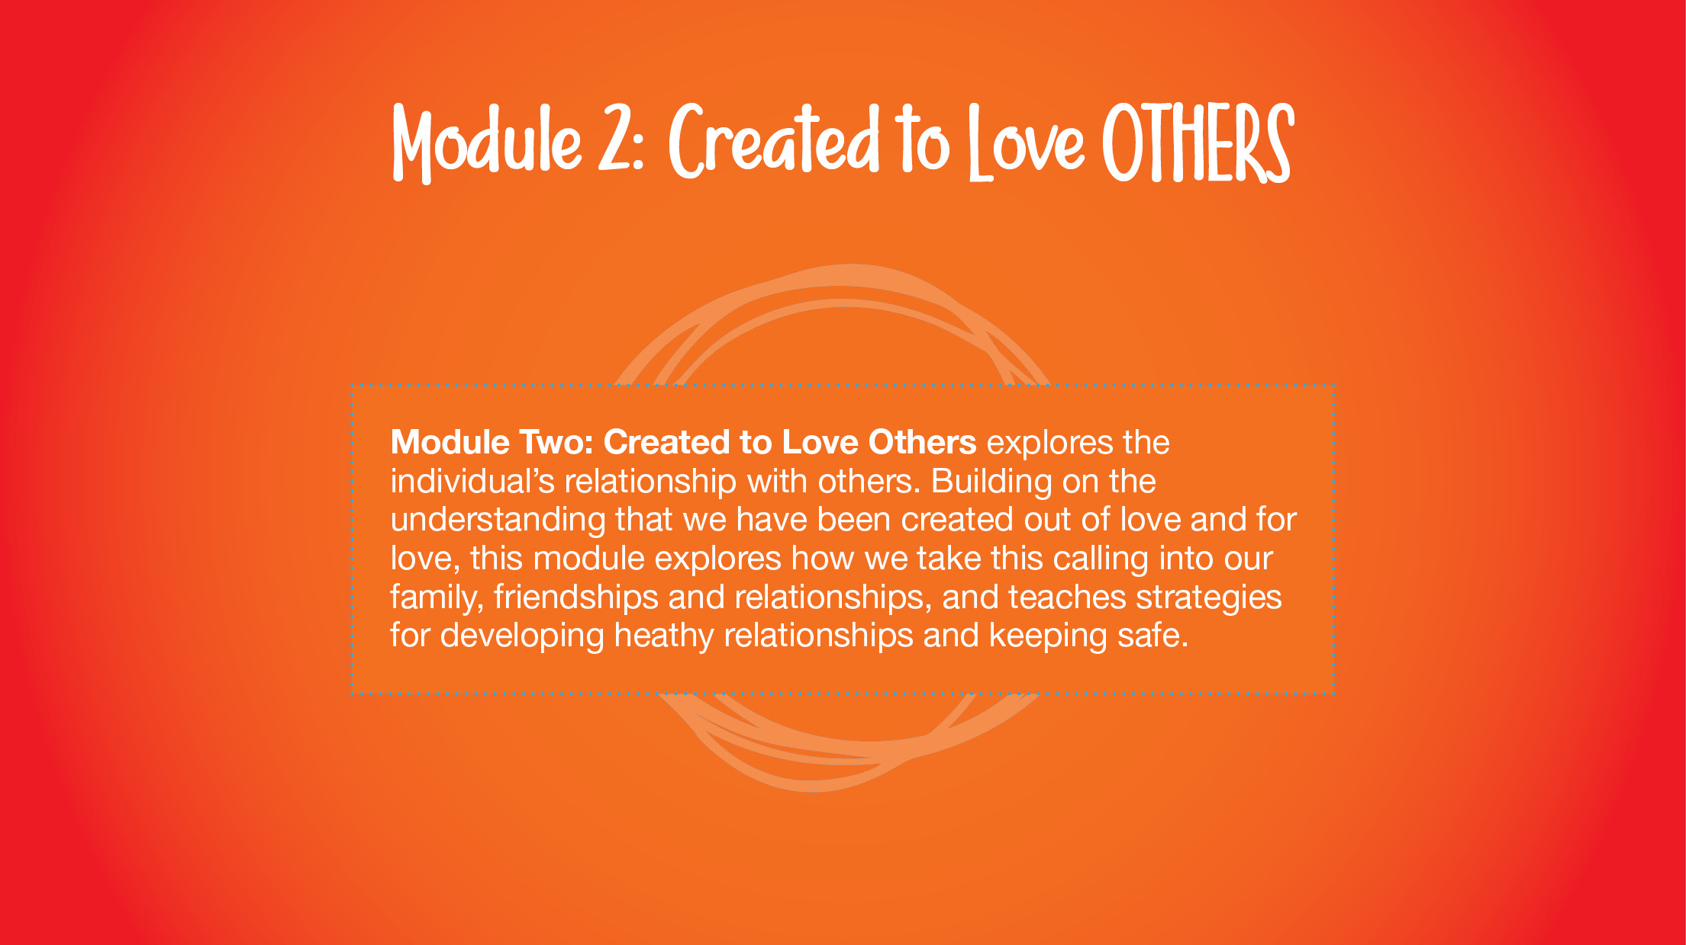

Slide 15


Slide 16
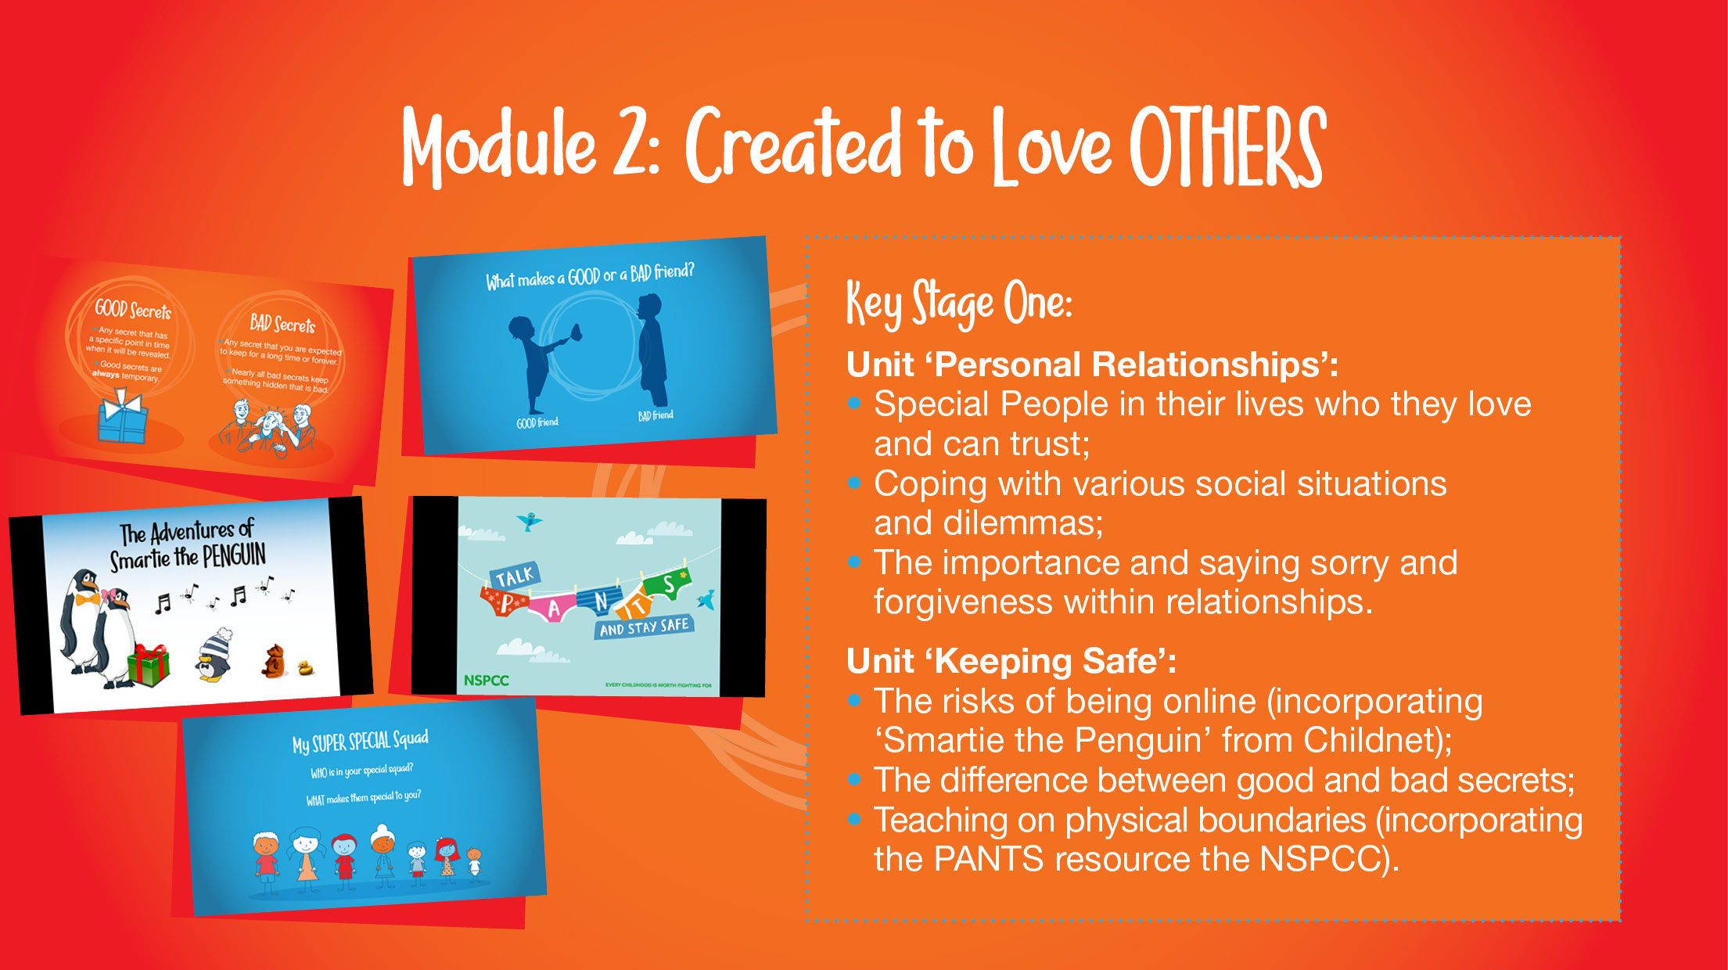

Slide 17
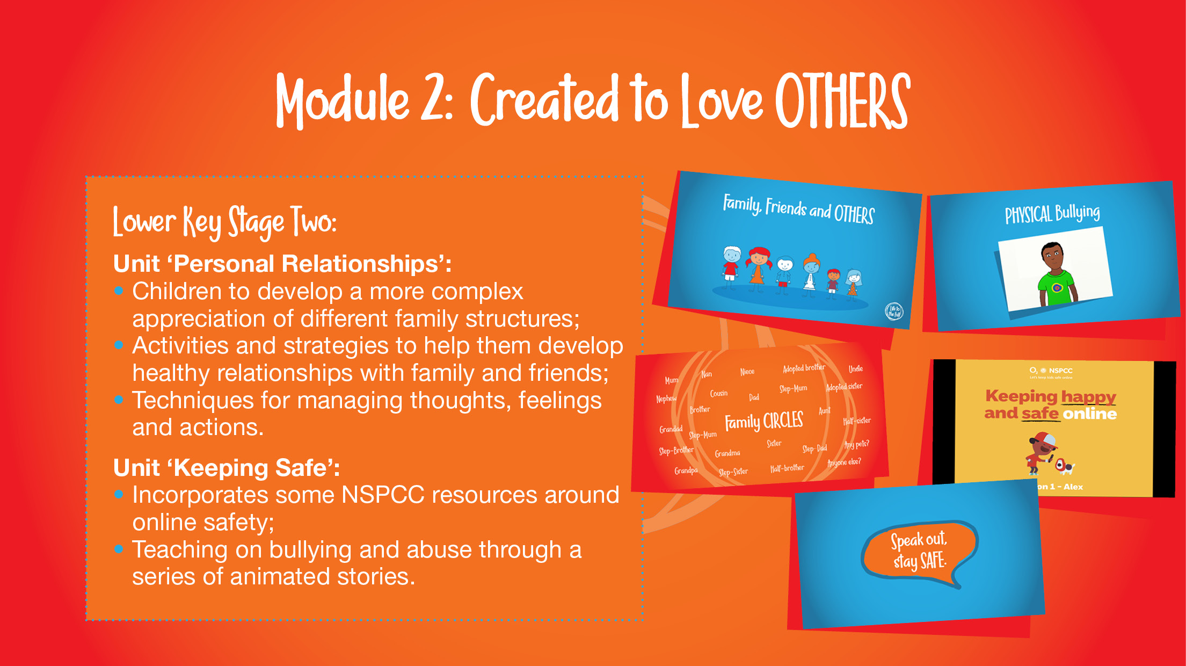

Slide 18
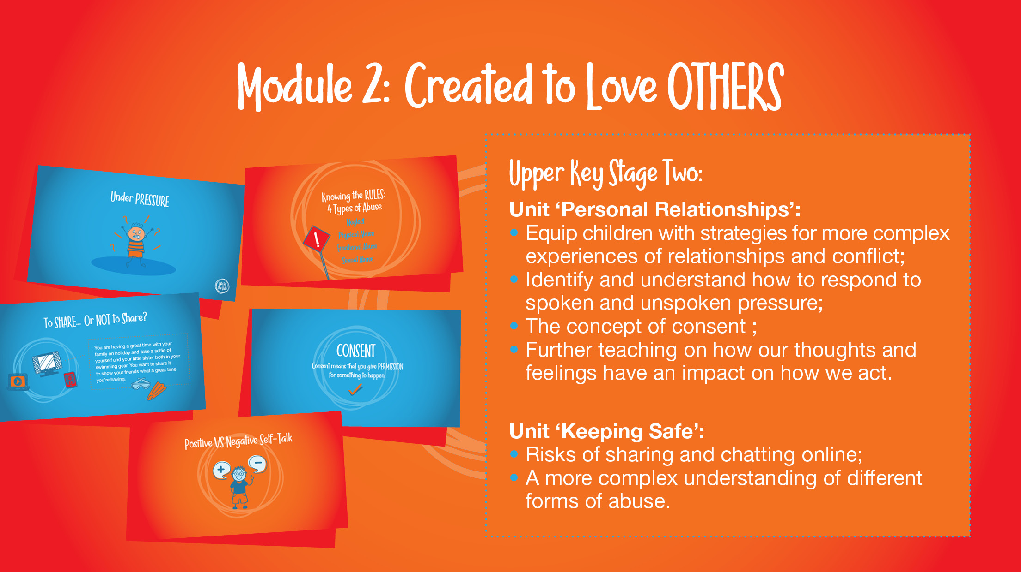

Slide 19
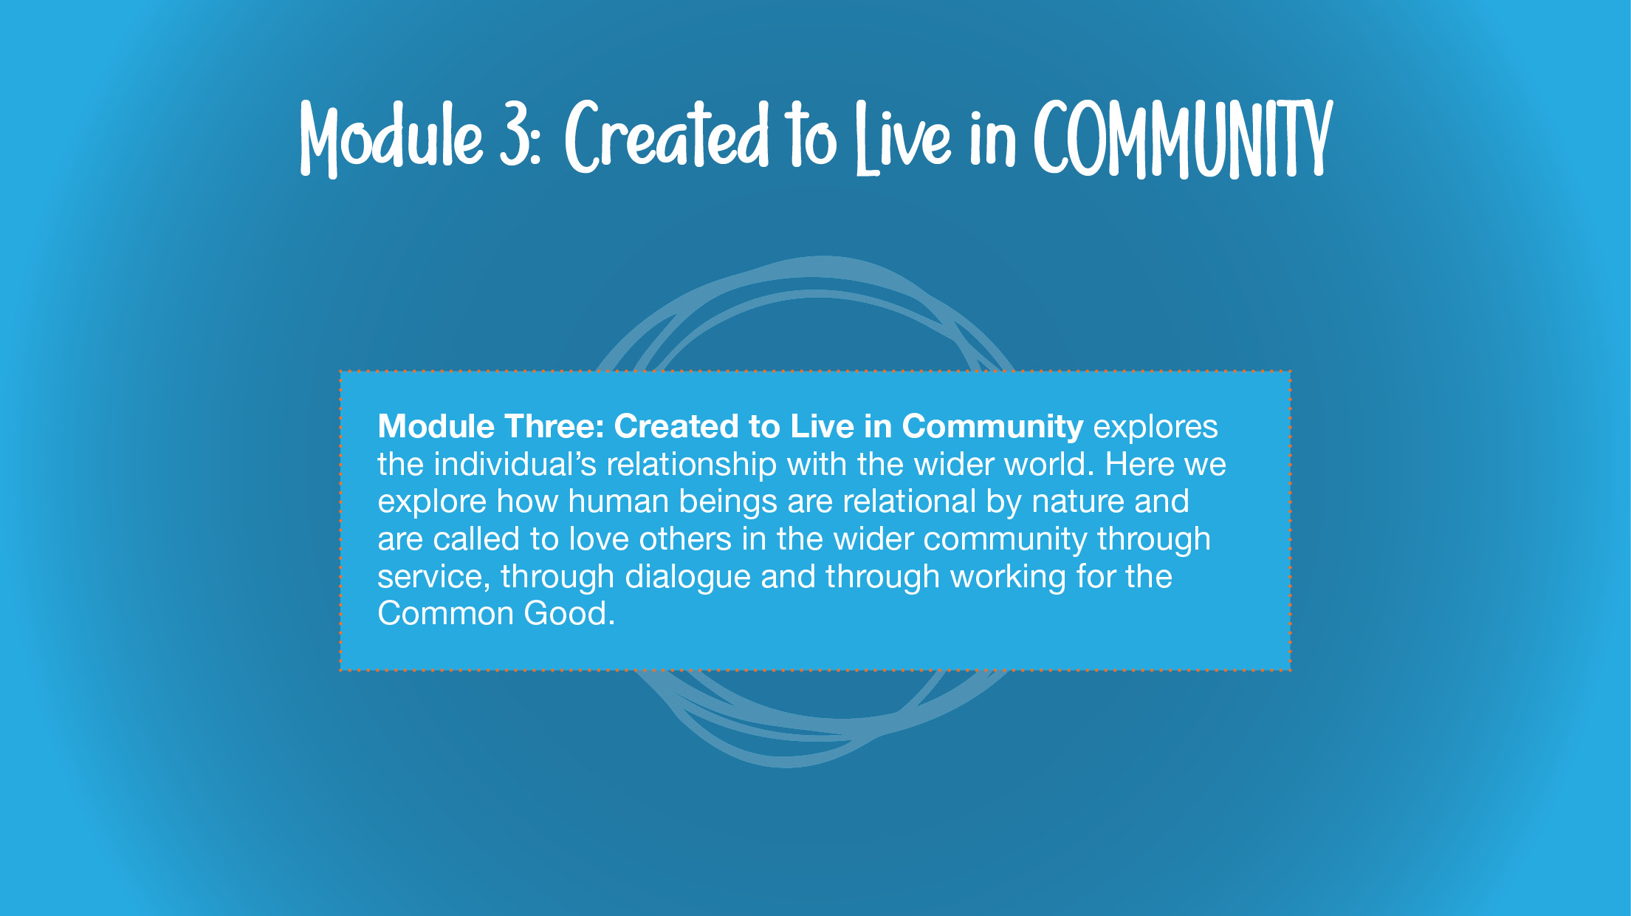

Slide 20
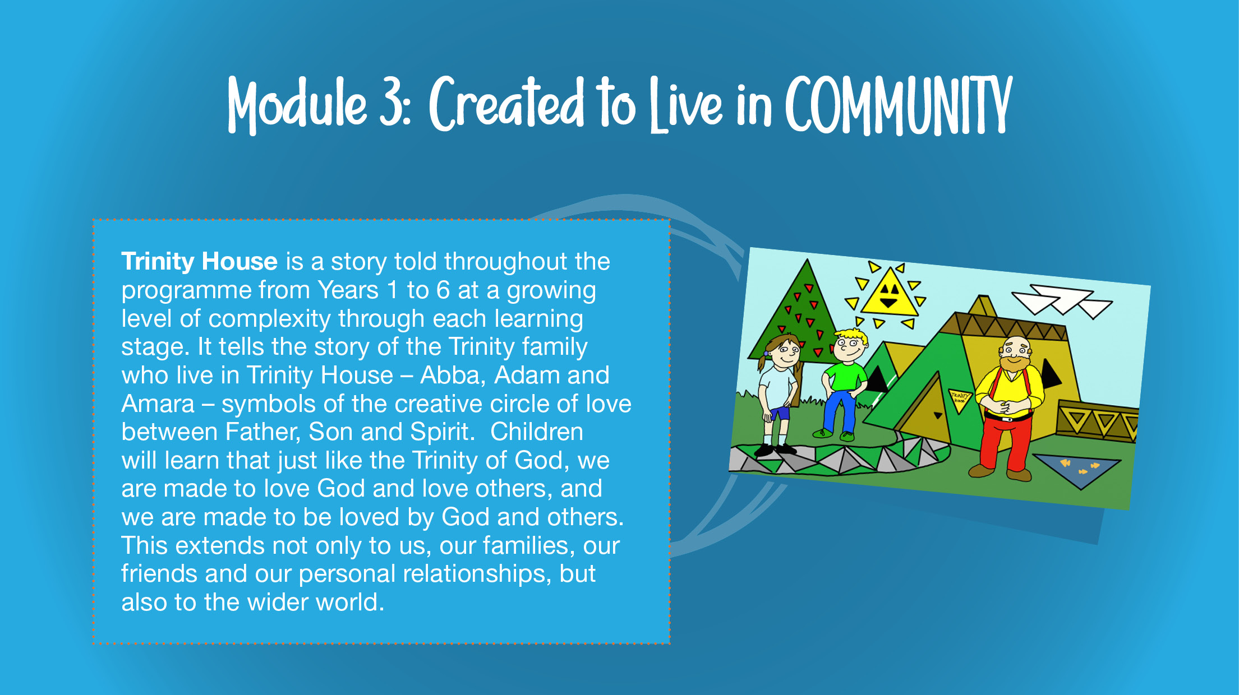

Slide 21
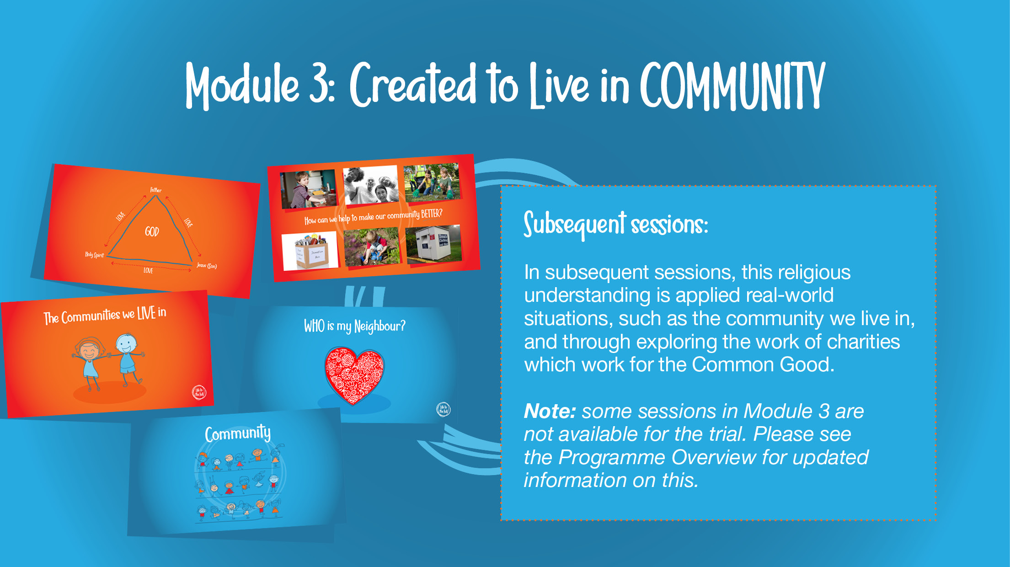

Slide 22
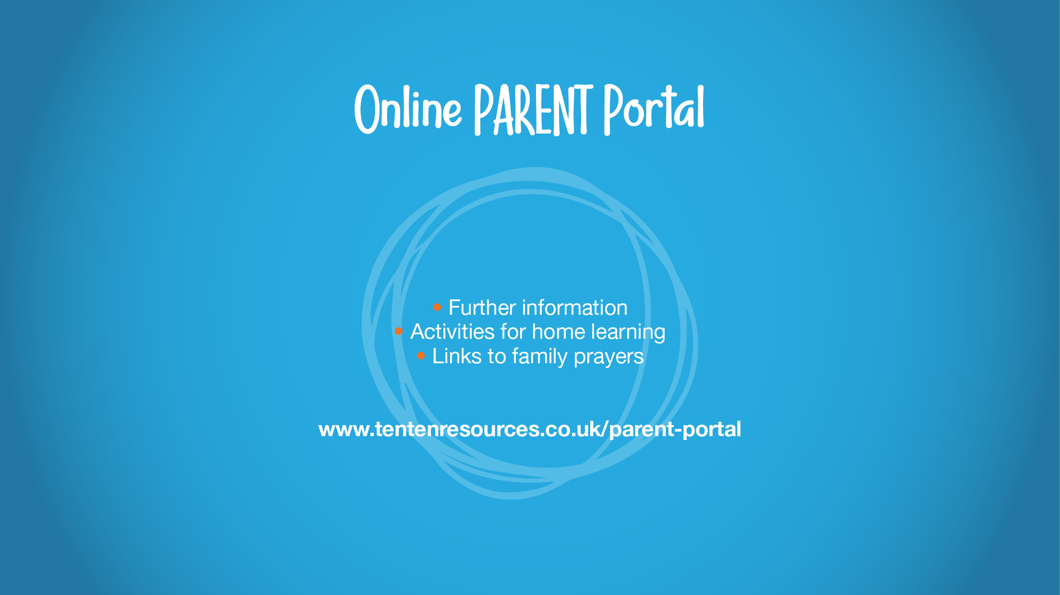


Slide 23


Thank you for taking the time to understand the RHSE programme we will be sharing with your children. Your views are valuable to us and we will take them into consideration during the decision making process.

